Slide 1
Uncertain Innovation and R&D Network Formation
Pascal Billand Christophe Bravard
Jacques Durieu Sudipta Sarangi

Slide 2
Motivation
Collaboration among firms in innovative activities is now widespread (Hagedoorn, 2002; Powell et al., 2005)

Slide 3
Motivation
Collaboration among firms in innovative activities is now widespread (Hagedoorn, 2002; Powell et al., 2005)
Majority of these collaborations are bilateral.

Slide 4
Motivation
Collaboration among firms in innovative activities is now widespread (Hagedoorn, 2002; Powell et al., 2005)
Majority of these collaborations are bilateral.
Understanding collaboration networks and their impact on the industry is important.

Slide 5
Motivation
Why do firms collaborate in R&D?
  Help by lowering R&D costs
  Help share the risk associated with innovation

Slide 6
Motivation
Why do firms collaborate in R&D?
  Help by lowering R&D costs
  Help share the risk associated with innovation
R&D collaborations do not always lead to an innovation.

Slide 7
Motivation
Why do firms collaborate in R&D?
  Help by lowering R&D costs
  Help share the risk associated with innovation
R&D collaborations do not always lead to an innovation.
Firms characteristics (technological, business or product similarity, geographical proximity) affect innovation success probability

Slide 8
Model features
Oligopoly setting in which (horizontally related) firms form pair-wise collaborative links with other firms.
These bilateral links require commitment of resources which are used for R&D.

Slide 9
Model features
Oligopoly setting in which (horizontally related) firms form pair-wise collaborative links with other firms.
These bilateral links require commitment of resources which are used for R&D.
Successful R&D leads to innovations.
If an innovation occurs it results in lower production costs for the firms involved in the link.

Slide 10
Related literature
Goyal and Moraga-Gonzales (2001); Goyal, Moraga-Gonzales and Konovalov (2008):
Analyze effort in R&D – the interaction between effort of a firm in collaboration link and their effort in other R&D projects in equilibrium.

Slide 11
Related literature
Goyal and Moraga-Gonzales (2001); Goyal, Moraga-Gonzales and Konovalov (2008):
Analyze effort in R&D – the interaction between effort of a firm in collaboration link and their effort in other R&D projects.
Konig et al. (2012)
Direct and indirect network spillovers matter, so every firm in a component has the same payoff. No market structure and strategic element is missing.

Slide 12
Related literature
Most directly related to Goyal and Joshi (2003)
Innovation between collaborating firms is pairwise and it occurs with certainty. Focus on the structure of equilibrium networks.

Slide 13
Related literature
Most directly related to Goyal and Joshi (2003)
Innovation between collaborating firms is pairwise and it occurs with certainty. Focus on the structure of equilibrium networks.
Westbrock (2010) and Billand et al. (2015)
Similar setting, but for welfare comparisons.

Slide 14
Structure of the Game
Stage 1: Firms simultaneously chose the collaborative R&D links they wish to form.
  These choices induce a network g
  They lower expected R&D costs

Slide 15
Structure of the Game
Stage 1: Firms simultaneously chose the collaborative R&D links they wish to form.
  These choices induce a network g
  They lower expected R&D costs
Stage 2: Firms play simultaneous oligopoly game

Slide 16

Model setup
N = {1, …, $i$, j, …, n}, n ≥ 3.

Slide 17
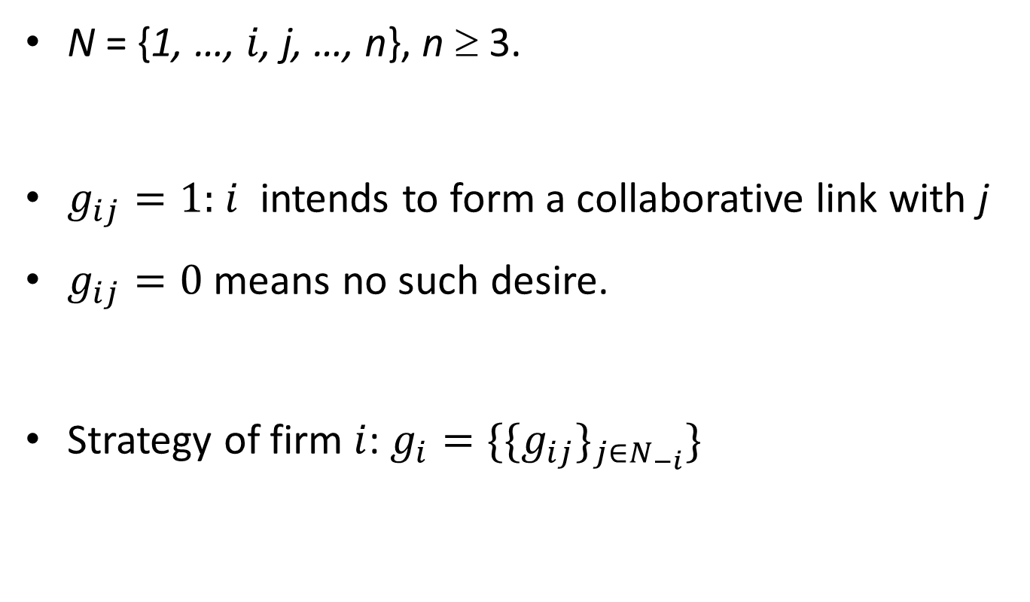
Model setup
N = {1, …, $i$, j, …, n}, n ≥ 3.
$g_{ij}=1:$ $i$ intends to form a collaborative link with j
$g_{ij}=0$ means no such desire.
Strategy of firm $i$: $g_{i}=\{{\{g_{ij}\}}_{j∈N_{−i}}\}$

Slide 18
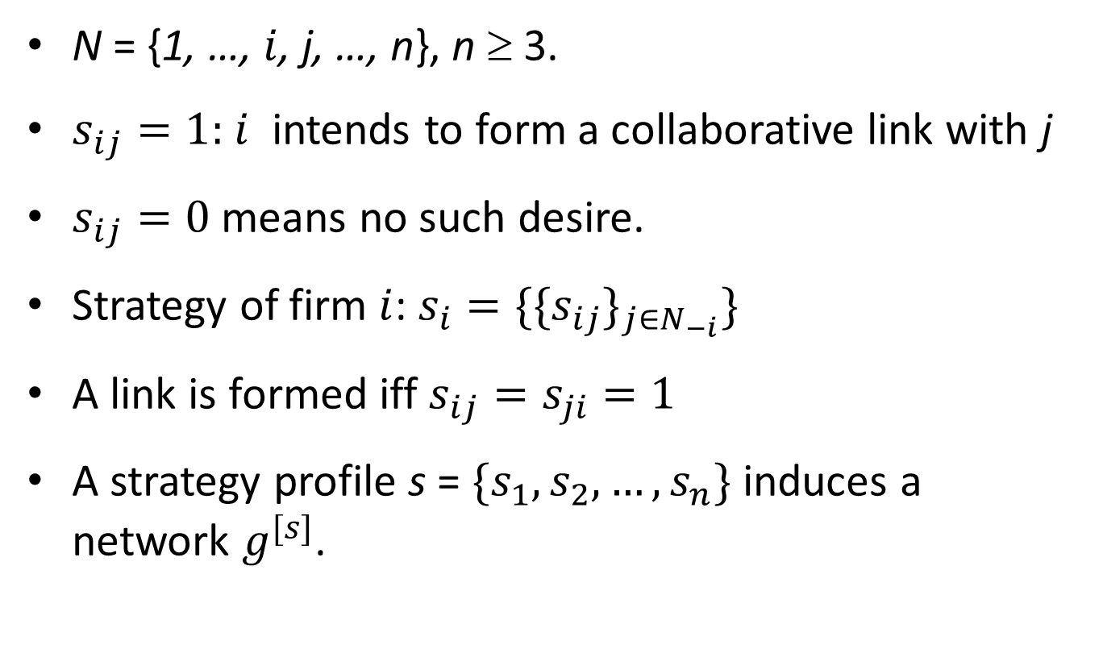
Model setup
N = {1, …, $i$, j, …, n}, n ≥ 3.
$s_{ij}=1:$ $i$ intends to form a collaborative link with j
$s_{ij}=0$ means no such desire.
Strategy of firm $i$: $s_{i}=\{{\{s_{ij}\}}_{j∈N_{−i}}\}$
A link is formed iff $s_{ij}=s_{ji}=1$
A strategy profile s = $\{s_{1}, s_{2}, …,s_{n}\}$ induces a network $g^{[s]}$.

Slide 19
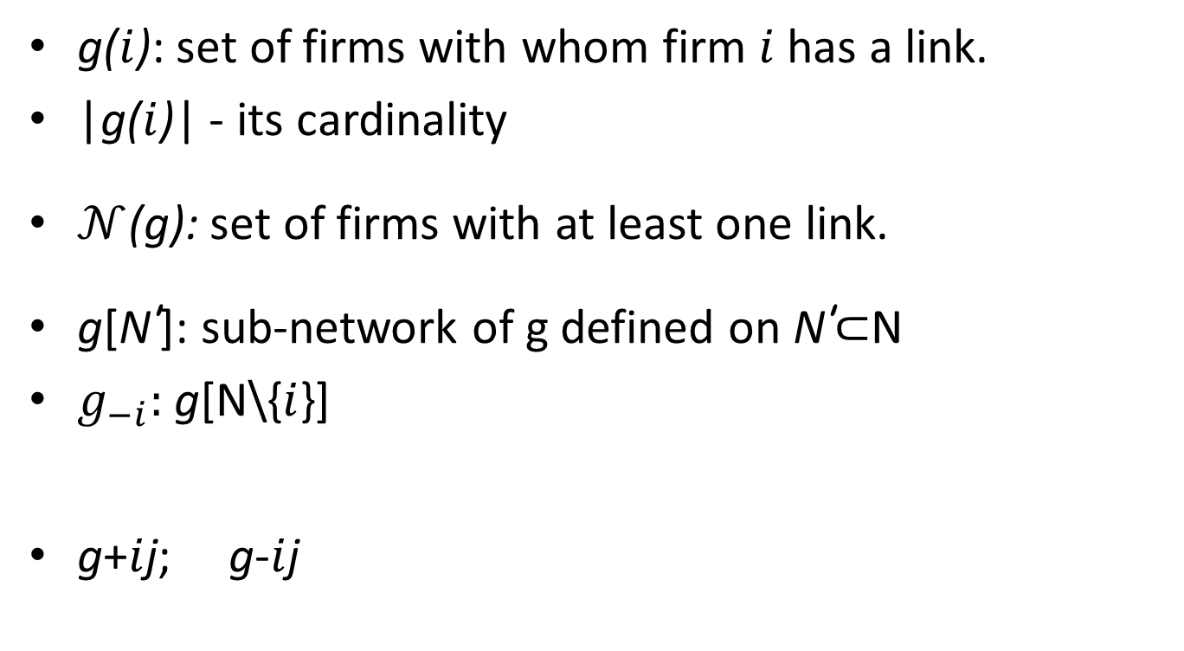
Model setup
g($i$): set of firms with whom firm $i$ has a link.
|g($i$)| - its cardinality
$𝒩$(g): set of firms with at least one link.
g[N’]: sub-network of g defined on N’⊂N
$g_{−i}:$ g[N\{$i$}]
g+$i$j; g-$i$j

Slide 20

Network architectures
  Complete and Empty
  Group dominant network: g[$𝒩$(g)] is complete.

Slide 21

Network architectures
2|2 hierarchical network: Partition g into 4 groups which are all complete and firms in $𝒩_{1}$ are linked only to firms in $𝒩_{2}$U $𝒩_{3}$ and firms in $𝒩_{2}$ are linked only to firms in $𝒩_{4}$.

Slide 22
Network architectures
Nested split graph: Have a nested neighborhood structure, i.e., the set of neighbors of each agent is contained in the set of neighbors of each higher degree agent.

Slide 23

Flows/probabilities of innovation
$ρ_{ij}∈\left(0,1\right]$: probablity that the R&D collaboration between $i$ and j yields a successful innovation

Slide 24
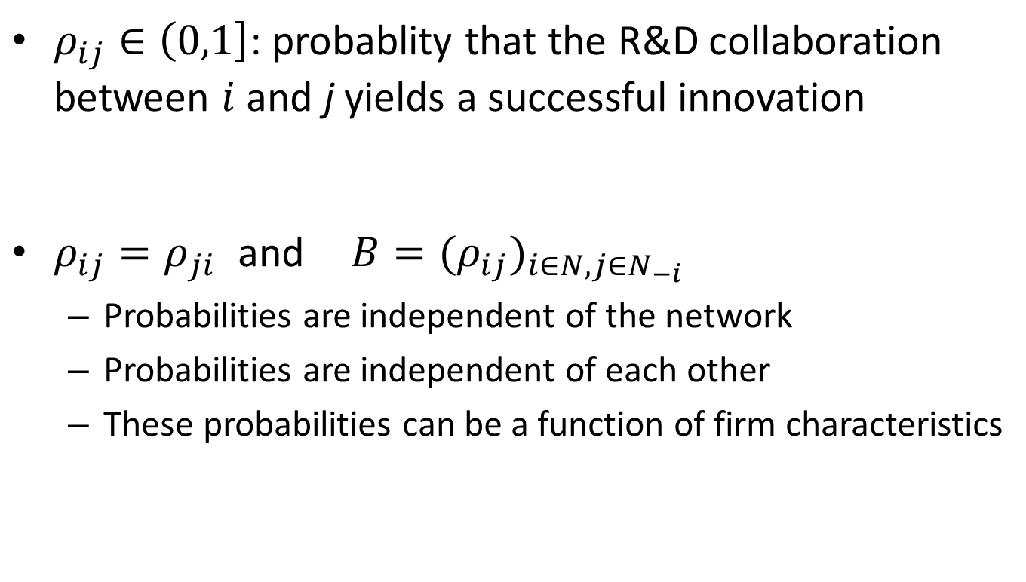
Flows/probabilities of innovation
$ρ_{ij}∈\left(0,1\right]$: probablity that the R&D collaboration between $i$ and j yields a successful innovation
$ρ_{ij}=ρ_{ji}$ and $B={(ρ_{ij})}_{i∈N, j∈N_{−i}}$
  Probabilities are independent of the network
  Probabilities are independent of each other
  These probabilities can be a function of firm characteristics

Slide 25
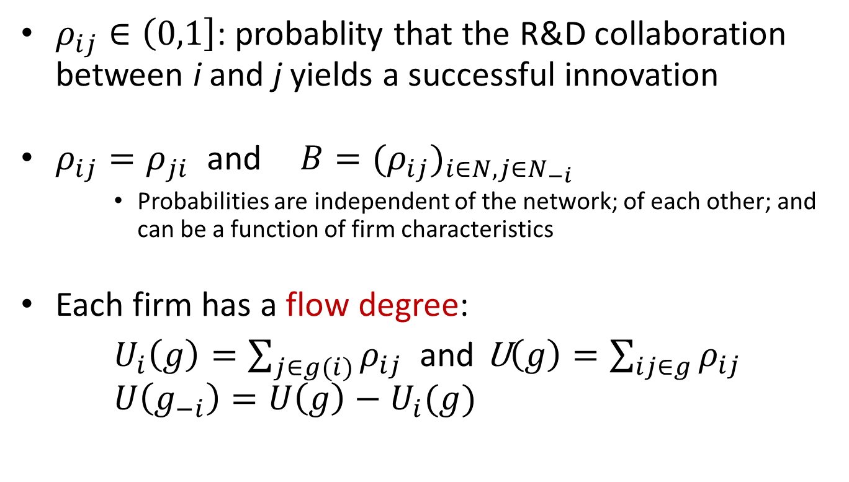
Flows/probabilities of innovation
$ρ_{ij}∈\left(0,1\right]$: probablity that the R&D collaboration between i and j yields a successful innovation
$ρ_{ij}=ρ_{ji}$ and $B={(ρ_{ij})}_{i∈N, j∈N_{−i}}$
    Probabilities are independent of the network; of each other; and can be a function of firm characteristics
Each firm has a flow degree:
$U_{i}\left(g\right)=\sum_{j∈g(i)}{ρ_{ij}}$ and U$\left(g\right)=\sum_{ij∈g}{ρ_{ij}}$ $U\left(g_{−i}\right)=U\left(g\right)−U_{i}(g)$

Slide 26
Stability concept
A network g is a pair-wise equilibrium network if the following conditions hold (Goyal and Joshi, 2006):
1. There is a Nash equilibrium strategy profile which supports g.

Slide 27
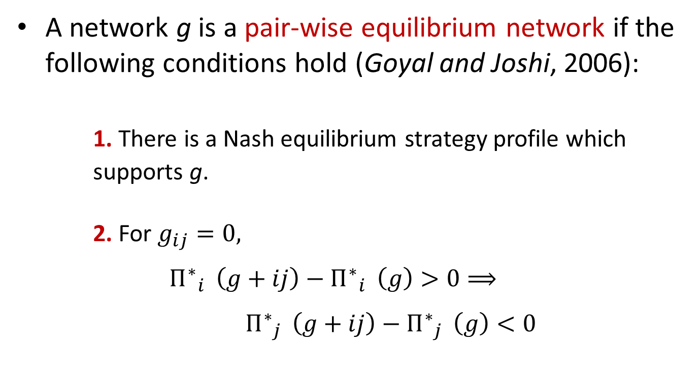
Stability concept
A network g is a pair-wise equilibrium network if the following conditions hold (Goyal and Joshi, 2006):
1. There is a Nash equilibrium strategy profile which supports g.
2. For $g_{ij}=0,$
${Π^{∗}}_{i}^{}\left(g+ij\right)−$ ${Π^{∗}}_{i}^{}\left(g\right)>0⟹$
${Π^{∗}}_{j}^{}\left(g+ij\right)−$ ${Π^{∗}}_{j}^{}\left(g\right)<0$

Slide 28
How innovations affects cost
Each R&D link requires a fixed investment: f > 0

Slide 29
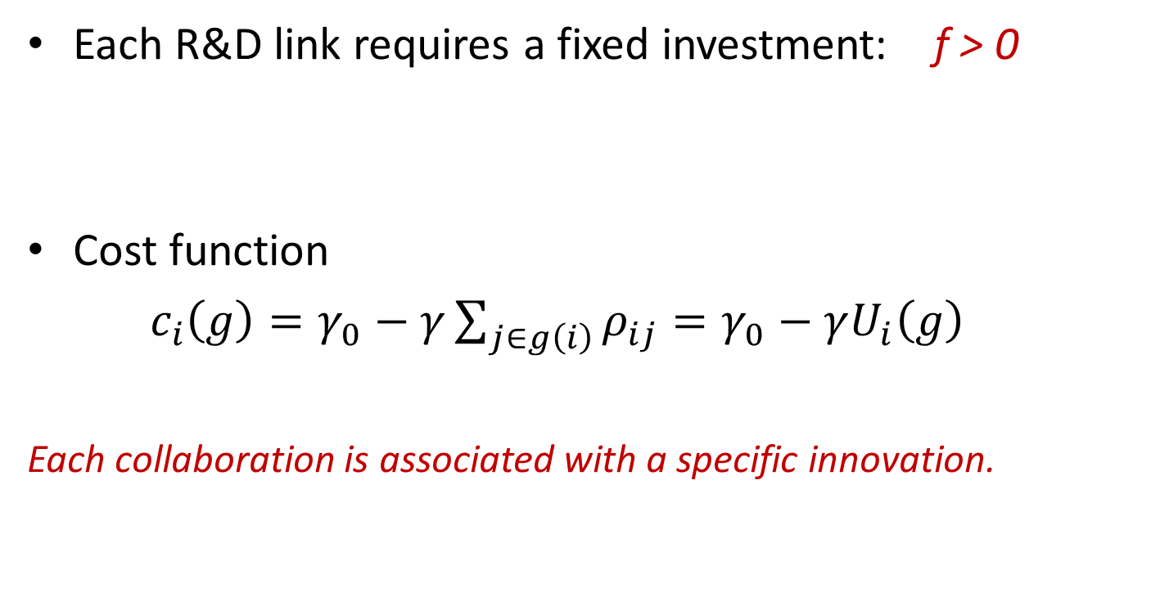
How innovations affects cost
Each R&D link requires a fixed investment: f > 0
Cost function
$c_{i}\left(g\right)=γ_{0}−γ\sum_{j∈g\left(i\right)}{ρ_{ij}}=γ_{0}−γU_{i}\left(g\right)$
Each collaboration is associated with a specific innovation.

Slide 30
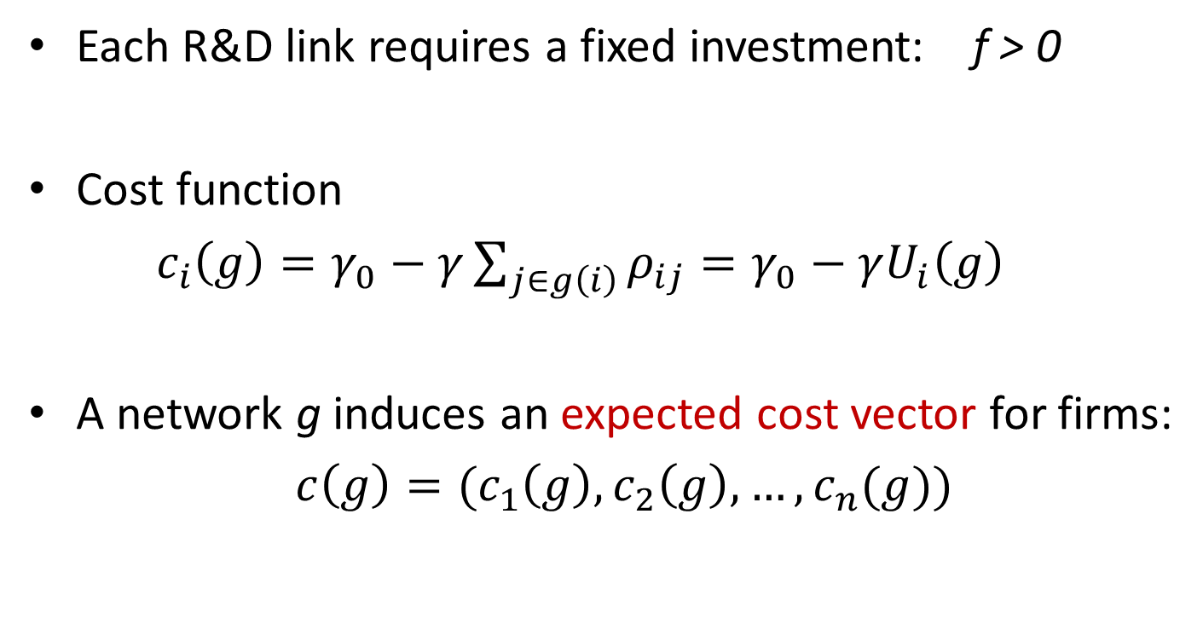
How innovations affects cost
Each R&D link requires a fixed investment: f > 0
Cost function
$c_{i}\left(g\right)=γ_{0}−γ\sum_{j∈g\left(i\right)}{ρ_{ij}}=γ_{0}−γU_{i}\left(g\right)$
A network g induces an expected cost vector for firms:
$c\left(g\right)={(c}_{1}\left(g\right),c_{2}\left(g\right), …, c_{n}(g))$

Slide 31

Homogeneous Cournot oligopoly
Demand: $p=α−\sum_{i∈N}{q_{i}}$

Slide 32
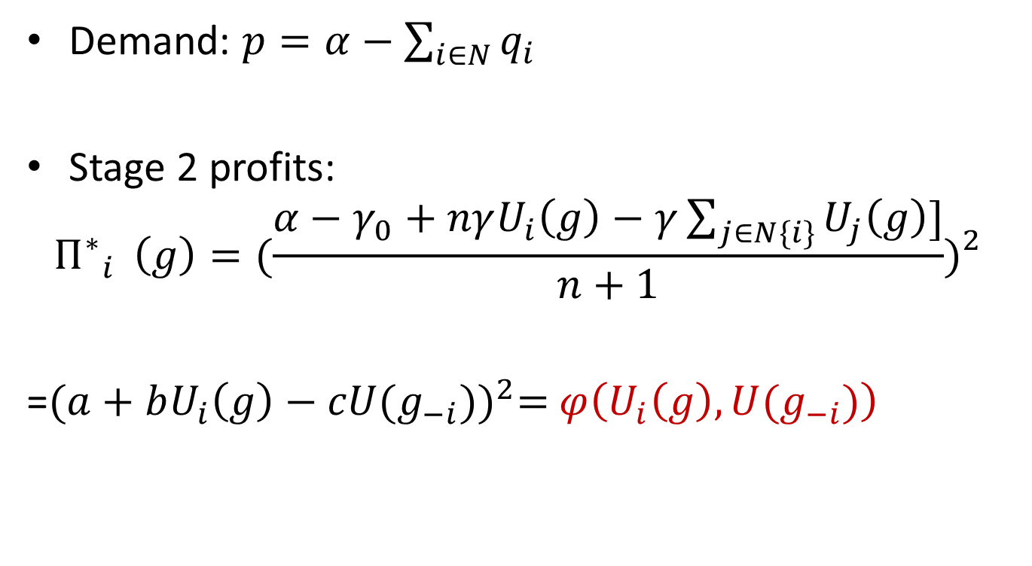
Homogeneous Cournot oligopoly
Demand: $p=α−\sum_{i∈N}{q_{i}}$
Stage 2 profits:
$${Π^{∗}}_{i}^{}\left(g\right)={(\frac{α−γ_{0}+nγU_{i}\left(g\right)−γ\sum_{j∈N\{i\}}{U_{j}\left(g\right)}]}{n+1})}_{}^{2}$$
=${(a+bU_{i}\left(g\right)−cU(g_{−i}))}^{2}=$ $φ\left(U_{i}\left(g\right),U(g_{−i})\right)$

Slide 33
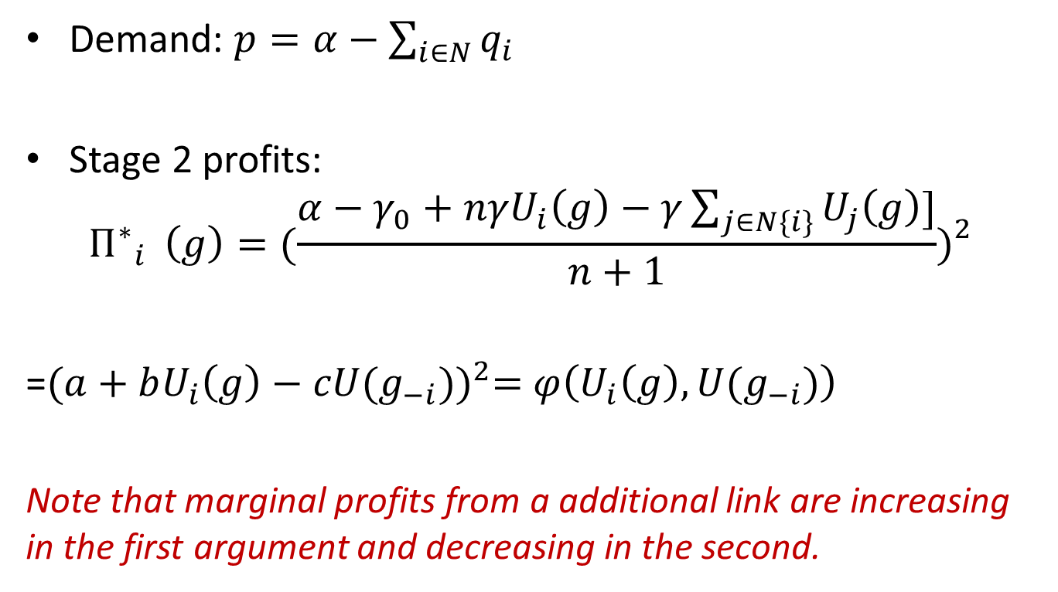
Homogeneous Cournot oligopoly
Demand: $p=α−\sum_{i∈N}{q_{i}}$
Stage 2 profits:
$${Π^{∗}}_{i}^{}\left(g\right)={(\frac{α−γ_{0}+nγU_{i}\left(g\right)−γ\sum_{j∈N\{i\}}{U_{j}\left(g\right)}]}{n+1})}_{}^{2}$$
=${(a+bU_{i}\left(g\right)−cU(g_{−i}))}^{2}=$ $φ\left(U_{i}\left(g\right),U(g_{−i})\right)$
Note that marginal profits from a additional link are increasing in the first argument and decreasing in the second.

Slide 34

Homogeneous Cournot oligopoly
Stage 1 profits: $\prod_{i}^{∗}{(g)}={Π^{∗}}_{i}^{}\left(g\right)−\left|g(i)\right|f$
CS = 1/2${(\frac{n\left(α−γ_{0}\right)+2γU(g)}{n+1})}^{2}=φ\left(U\left(g\right)\right)$

Slide 35
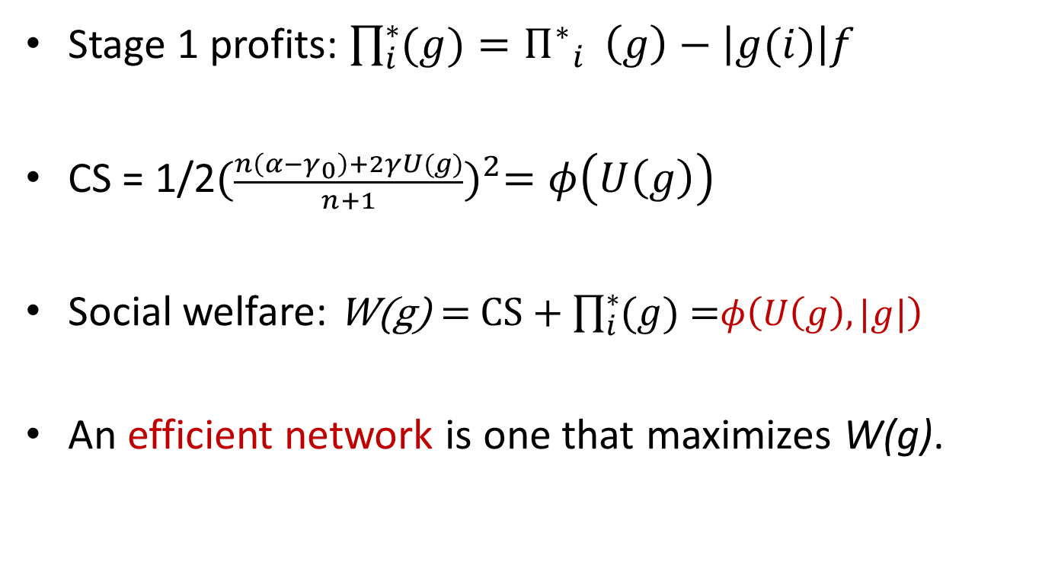
Homogeneous Cournot oligopoly
Stage 1 profits: $\prod_{i}^{∗}{(g)}={Π^{∗}}_{i}^{}\left(g\right)−\left|g(i)\right|f$
CS = 1/2${(\frac{n\left(α−γ_{0}\right)+2γU(g)}{n+1})}^{2}=φ\left(U\left(g\right)\right)$
Social welfare: W(g) = CS + $\prod_{i}^{∗}{(g)}$ =$φ\left(U\left(g\right), |g|\right)$
An efficient network is one that maximizes W(g).

Slide 36
Too many probabilities?
Can we use stylized facts to improve things?
  Characteristics like geographical, technological or business similarities of firms matter.

Slide 37
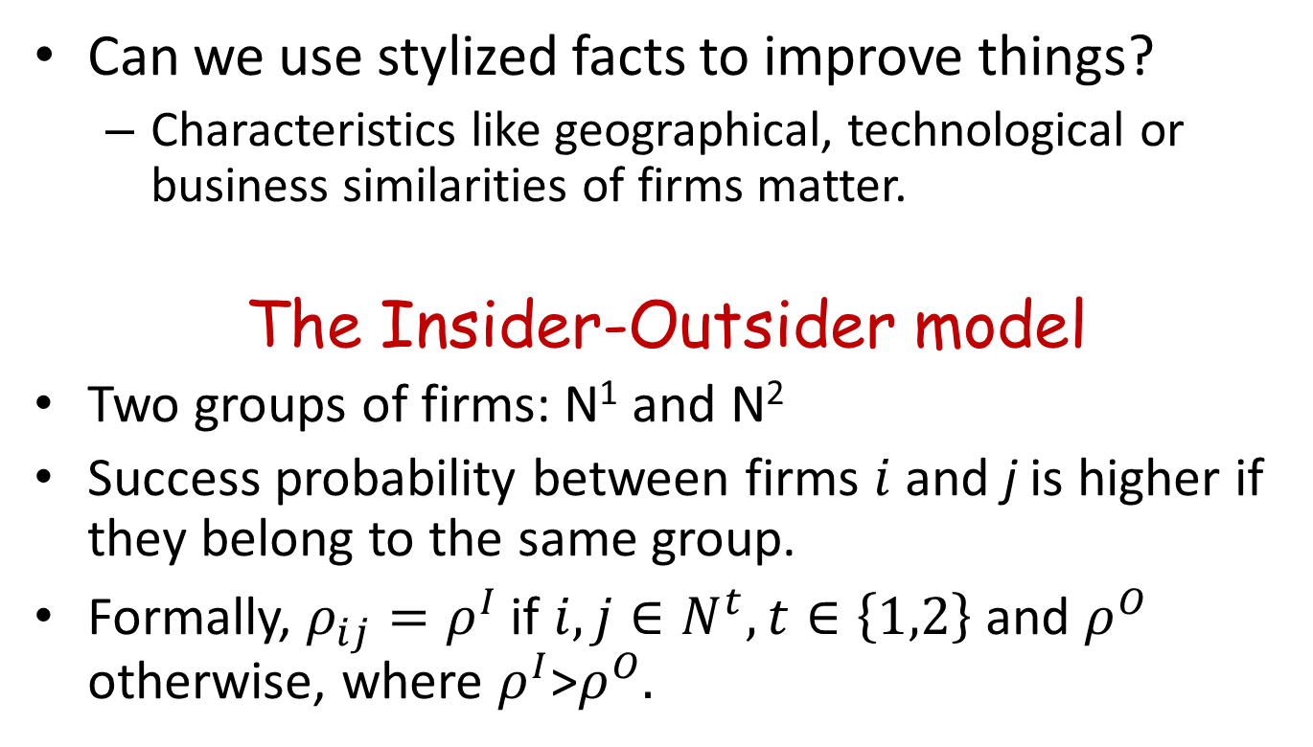
Too many probabilities?
Can we use stylized facts to improve things?
  Characteristics like geographical, technological or business similarities of firms matter.
The Insider-Outsider model
Two groups of firms: N¹ and N²
Success probability between firms $i$ and j is higher if they belong to the same group.
Formally, $ρ_{ij}=ρ^{I}$ if $i,j∈N^{t}, t∈\left\{1,2\right\}$ and $ρ^{O}$ otherwise, where $ρ^{I}$>$ρ^{O}.$

Slide 38
Too many probabilities?
Can we use stylized facts to improve things?
  Some firms are more aggressive about innovations
  Firms with greater market share are more likely to be innovators

Slide 39
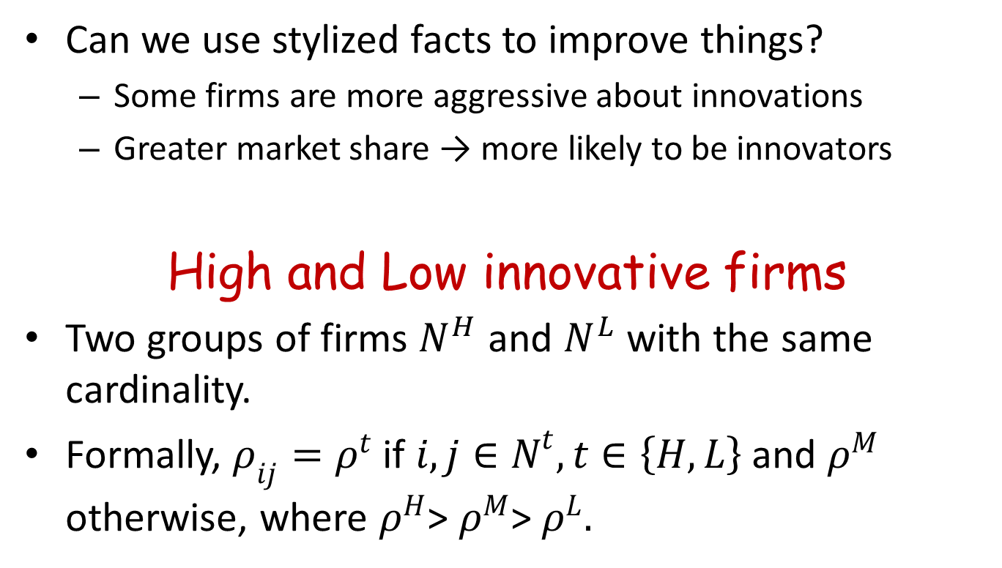
Too many probabilities?
Can we use stylized facts to improve things?
  Some firms are more aggressive about innovations
  Greater market share → more likely to be innovators
High and Low innovative firms
Two groups of firms $N^{H}$ and $N^{L}$ with the same cardinality.
Formally, $ρ_{ij}=ρ^{t}$ if $i,j∈N^{t}, t∈\left\{H,L\right\}$ and $ρ^{M}$ otherwise, where $ρ^{H}$> $ρ^{M}$> $ρ^{L}.$

Slide 40
Results: Pws-Equilibrium
Proposition 0: What if links are not costly?
Suppose f = 0. Then a pair-wise equilibrium network is the complete network.

Slide 41
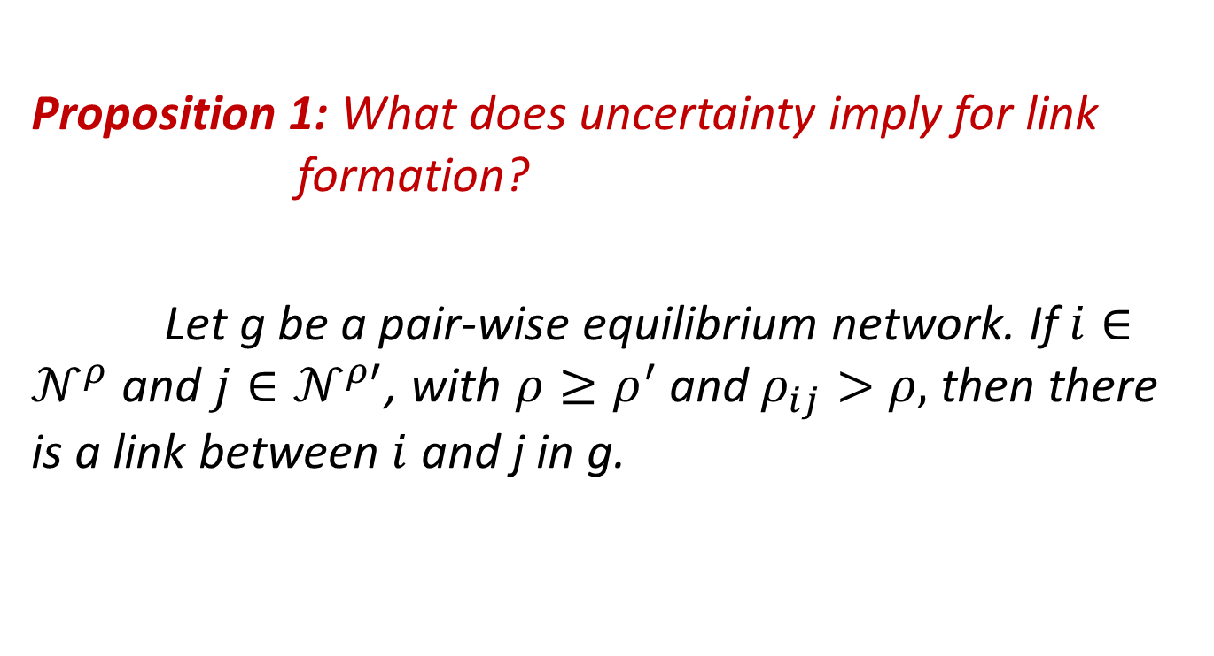
Results: Pws-Equilibrium
Proposition 1: What does uncertainty imply for link formation?
Let g be a pair-wise equilibrium network. If $i∈𝒩^{ρ}$ and $j∈𝒩^{ρ′}$, with $ρ≥ρ^{′}$ and $ρ_{ij}>$ $ρ,$ then there is a link between $i$ and j in g.

Slide 42
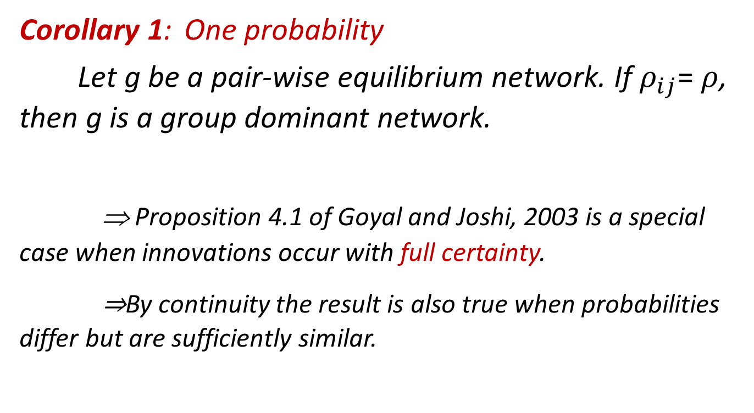
Results: How probabilities matter…
Corollary 1: One probability
Let g be a pair-wise equilibrium network. If $ρ_{ij}$= $ρ$, then g is a group dominant network.
⇒ Proposition 4.1 of Goyal and Joshi, 2003 is a special case when innovations occur with full certainty.
⇒By continuity the result is also true when probabilities differ but are sufficiently similar.

Slide 43
Results: How probabilities matter…
Corollary 2: Two probabilities
Suppose the assumptions of the I-O framework are satisfied. If g is a non-empty pair-wise equilibrium network, then it is a group dominant network, or a 2-group dominant network or a 2|2 hierarchical network.

Slide 44
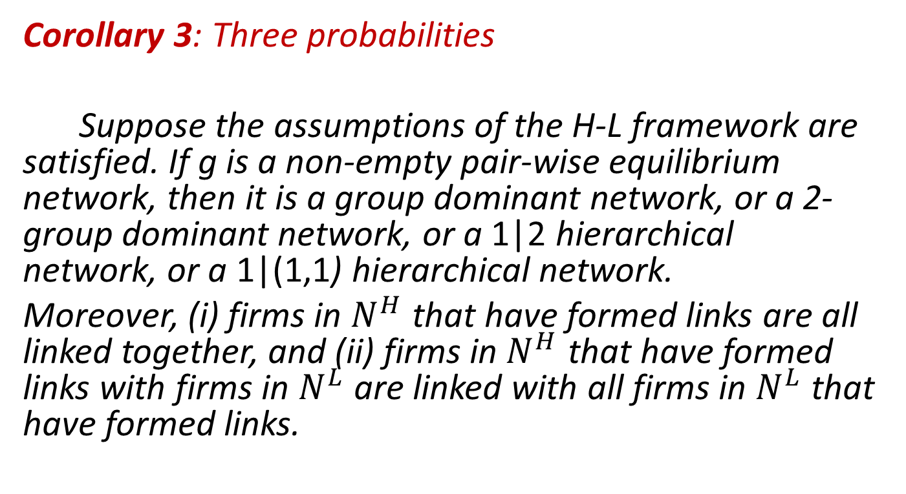
Results: How probabilities matter…
Corollary 3: Three probabilities
Suppose the assumptions of the H-L framework are satisfied. If g is a non-empty pair-wise equilibrium network, then it is a group dominant network, or a 2-group dominant network, or a 1|2 hierarchical network, or a 1|(1,1) hierarchical network.
Moreover, (i) firms in $N^{H}$ that have formed links are all linked together, and (ii) firms in $N^{H}$ that have formed links with firms in $N^{L}$ are linked with all firms in $N^{L}$ that have formed links.

Slide 45
Network architectures

Slide 46
Results: How probabilities matter…
Pairwise equilibrium networks are group dominant networks or variations (hierarchical versions) of those.
The most valuable links may not be formed in a pairwise stable network.

Slide 47
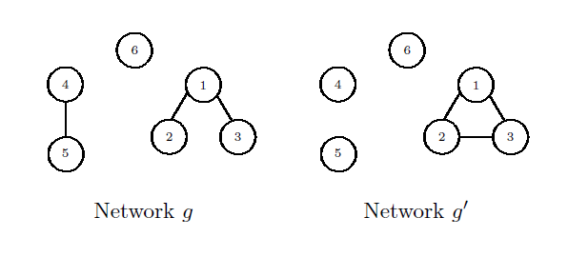
Results
Proposition 2 (Idea): Non monotonicity of pw-equilibrium
There exist situations in which: If the success probabilities of links in a pw-equilibrium increase, then some existing links may be deleted.

Slide 48
Results
Proposition 2 (Idea): Non monotonicity of pw-equilibrium
There exist situations in which: If the success probabilities of links in a pw-equilibrium increase, then some existing links may be deleted.
- Welfare is lower in the new equilibrium.
- This has implications for policy.

Slide 49
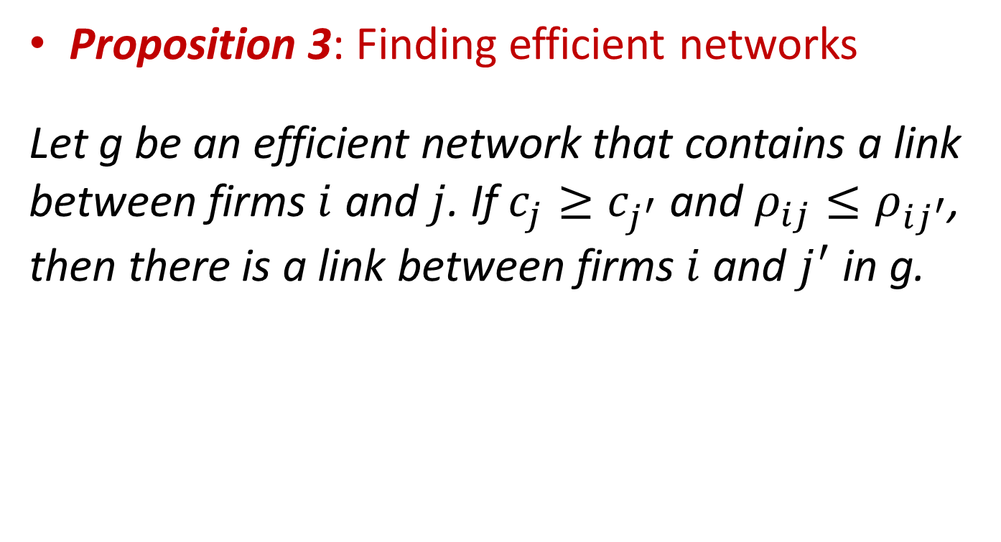
Results: Welfare
Proposition 3: Finding efficient networks
Let g be an efficient network that contains a link between firms $i$ and $j$. If $c_{j}≥c_{j^{′}}$ and $ρ_{ij}≤ρ_{ij^{′}}$, then there is a link between firms $i$ and $j^{′}$ in g.

Slide 50

Results: Welfare
Corollary 4: One probability
Suppose that for all $i,j∈N$, $ρ_{ij}$= $ρ$, then an efficient network is a NSG.

Slide 51
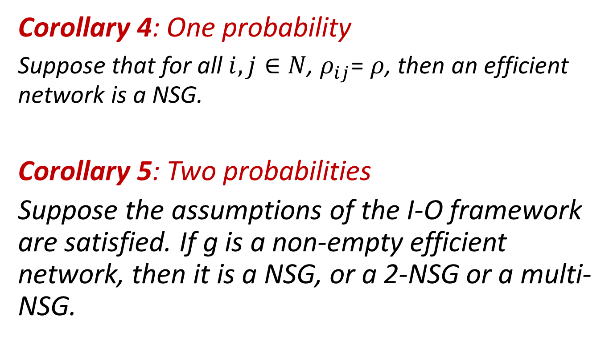
Results: Welfare
Corollary 4: One probability
Suppose that for all $i,j∈N$, $ρ_{ij}$= $ρ$, then an efficient network is a NSG.
Corollary 5: Two probabilities
Suppose the assumptions of the I-O framework are satisfied. If g is a non-empty efficient network, then it is a NSG, or a 2-NSG or a multi-NSG.

Slide 52
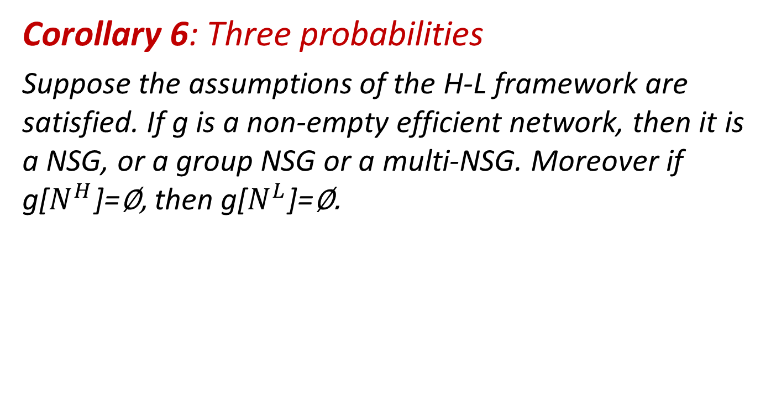
Results: Welfare
Corollary 6: Three probabilities
Suppose the assumptions of the H-L framework are satisfied. If g is a non-empty efficient network, then it is a NSG, or a group NSG or a multi-NSG. Moreover if g[$N^{H}$]=∅, then g[$N^{L}$]=∅.

Slide 53
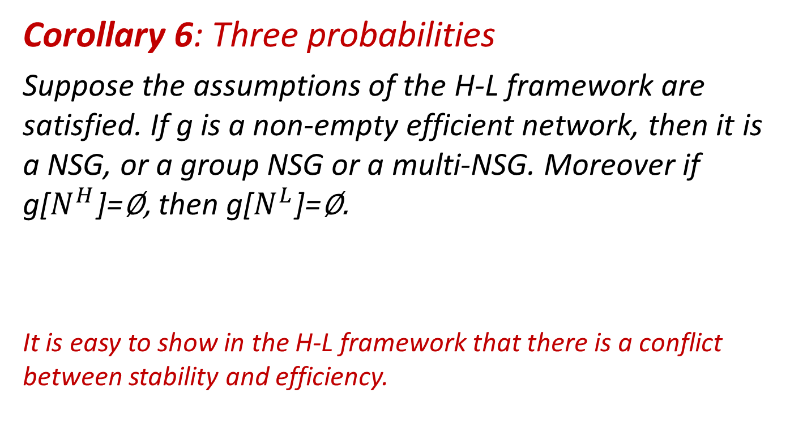
Results: Welfare
Corollary 6: Three probabilities
Suppose the assumptions of the H-L framework are satisfied. If g is a non-empty efficient network, then it is a NSG, or a group NSG or a multi-NSG. Moreover if g[$N^{H}$]=∅, then g[$N^{L}$]=∅.
It is easy to show in the H-L framework that there is a conflict between stability and efficiency.

Slide 54
Nested split graphs

Slide 55

Results
Proposition 4: About a larger class of oligopoly games
Let $Π_{i}\left(g\right)= σ(U_{i}\left(g\right), U(g_{−i}))$

Slide 56
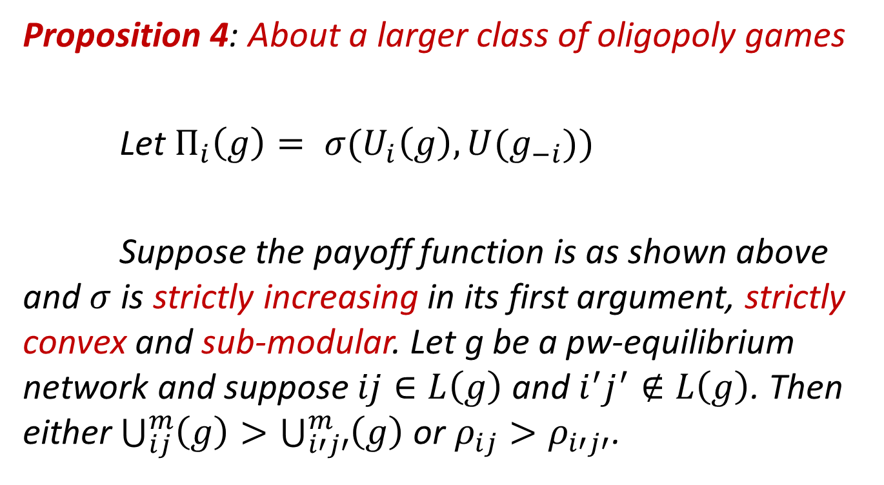
Results
Proposition 4: About a larger class of oligopoly games
Let $Π_{i}\left(g\right)= σ(U_{i}\left(g\right), U(g_{−i}))$
Suppose the payoff function is as shown above and $σ$ is strictly increasing in its first argument, strictly convex and sub-modular. Let g be a pw-equilibrium network and suppose $ij∈L\left(g\right)$ and $i^{′}j^{′}∉L\left(g\right)$. Then either $\bigcup_{ij}^{m}{\left(g\right)>\bigcup_{i′j′}^{m}{\left(g\right)}}$ or $ρ_{ij}>ρ_{i′j′}$.

Slide 57
Results
These results hold for the differentiated Cournot and Bertrand models.
Analogous version of Proposition 1 (Corollary 7) will exist in this case.
Non-monotonicity in links (Proposition 2) result will hold
Conditions for efficient networks are shown (Proposition 5) and an analogous version of Proposition 3 can be shown.

Slide 58
Summing up
On introducing uncertainty we find that
  Pws-equilibrium networks are dominant networks or their variations, i.e., Goyal and Joshi (2003) is a special case.
  Efficient networks are variations of NSG, i.e., Westbrock (2010) and Billand et al. (2015) are special cases.

Slide 59
Summing up
On introducing uncertainty we find that
  Pws-equilibrium networks are dominant networks or their variations, i.e., Goyal and Joshi (2003) is a special case.
  Efficient networks are variations of NSG, i.e., Westbrock (2010) and Billand et al. (2015) are special cases.
Public policy aimed at increasing innovative activity has to be done carefully.
Results can be extended to a general class of games.

Slide 60
Two things…
Goyal and Joshi (2003) use 3 properties to obtain their results:
  All links lead to the same reduction in marginal costs
  The profit function is convex in own links
  The profit function is sub-modular

Slide 61
Two things…
Goyal and Joshi (2003) use 3 properties to obtain their results:
  All links lead to the same reduction in marginal costs
  The profit function is convex in own links
  The profit function is sub-modular
Uncertainty not only makes the model more realistic, it introduces heterogeneity and relaxes (1)
  Alters the formal analysis
  Goyal and Joshi (2003) is a special case

Slide 62
Two things…
What if firms can absorb innovations at different rates?
  The same innovation can affect two firms differently.

Slide 63
Two things…
What if firms can absorb innovations at different rates?
  The same innovation can affect two firms differently.
⇒ A “tyranny of the weakest” type situation in equilibrium.
⇒ Positive assortative matching in equilibrium.

Slide 64


